Slide 1
Using Generalized Query Tree to cope with the Capture Effect in RFID Singulation
Victor K. Y. Wu
Department of Electrical Engineering
Roy H. Campbell
Department of Computer Science

Slide 2
Agenda
RFID Singulation
System Model
Query Tree Protocol (QT)
Capture Effect
Generalized Query Tree Protocols
Singulation Time Simulations

Slide 3
RFID Singulation
Radio frequency identification. (Passive only.)
A tag with a unique ID is affixed to an object.
A reader acquires the tag ID to learn information about the object from a database.
Backscattering.
Singulation: A single reader collects all the IDs of all tags in its broadcast range. Collision resolution protocol.

Slide 4
RFID Singulation
Two classes of singulation.
Probabilistic (similar to Aloha): Reader broadcasts query. Tags respond in random time slots. Repeat.
Deterministic: Reader successively sends longer bit string prefix. Tags with matching IDs respond. Grow Tree.
We modify deterministic approach to deal with capture effect.

Slide 5
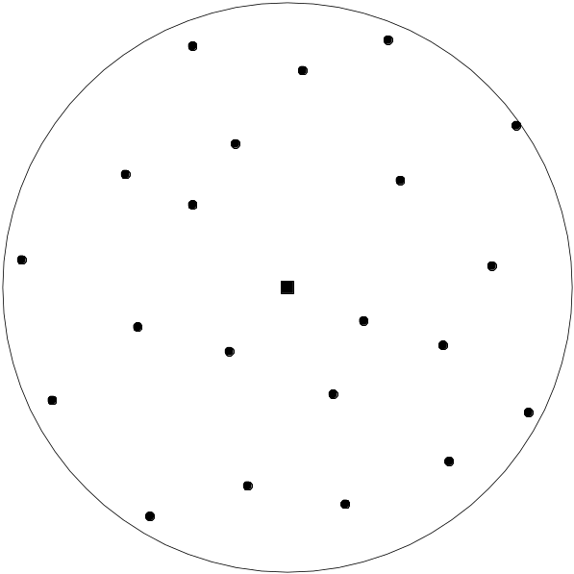
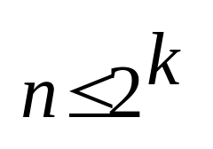
System Model
A single reader. Disk represents transmit range.
Reader has one antenna.
Signals broadcast omni-directionally.
No a priori knowledge of n.
n tags distributed uniformly.
Each tag has unique k-bit ID.

Slide 6
Query Tree Protocol (QT)
QT [Law et al].
Reader repeatedly sends prefix and waits for response.
Tags with matching IDs respond with ID.
Collision if multiple responses. In that case, extend prefix and repeat.
Each query prefix associated with a node in binary tree.

Slide 7
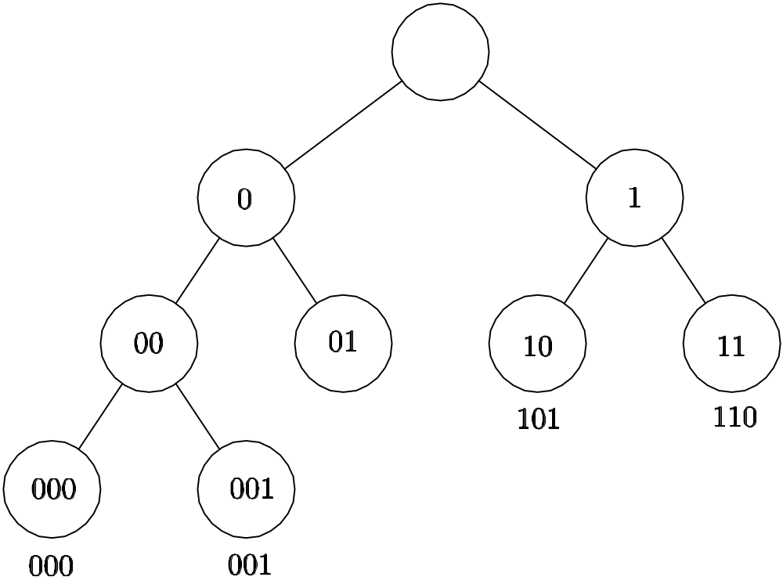
Query Tree Protocol (QT)
4 tags with IDs
{000,001,101,110}

Slide 8
Capture Effect
QT assumes {no response, one response, collision}, i.e. physical layer decoding assumption.
Capture effect: Reader maybe decodes an ID in presence of interfering signals.
We only assume {no response, response}.
No response: No tags replied.
Response: At least one tag replied. Maybe decode an ID.

Slide 9
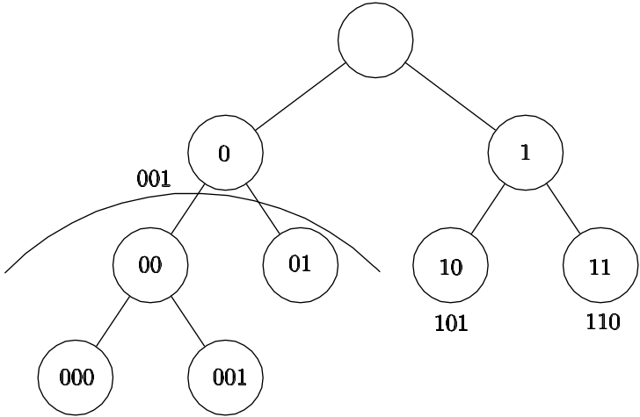
Capture Effect
3-state QT: No capture effect occurs.
2-state QT: Capture effect.
4 tags with IDs
{000,001,101,110}

Slide 10
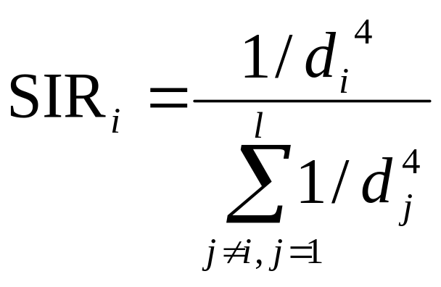
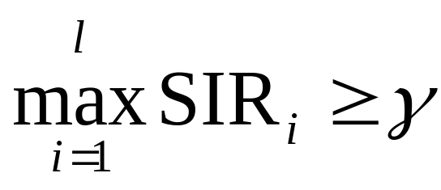
Capture Effect
Model capture effect using SIR of reader receiver.
Free space, path loss propagation.

Slide 11
Generalized Query Tree
Generalized Query Tree Protocols (GQT1 and GQT2).
Modify QT.

Slide 12
GQT1
Modify QT.
Stopping condition: No response. Contrast with QT.
Always lengthen prefix if no response.
After ID decoded, send ACK to tag.
e.g. tag IDs {10000, 10111, 10110}. Prefix is 10. 10000 decoded due to capture effect. New prefix is 100.

Slide 13
GQT2
Modify GQT1
Re-broadcast same prefix if decode an ID.
Try to “capture” more tags with same prefix.
e.g. tag IDs {10000, 10111, 10110}. Prefix is 10. 10000 decoded due to capture effect. Re-broadcast 10.

Slide 14
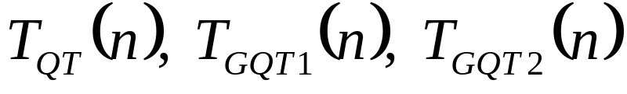
Singulation Time
Time required to singulate n tags.
T->R and R->T each take 1/2 time unit.
Compare:

Slide 15
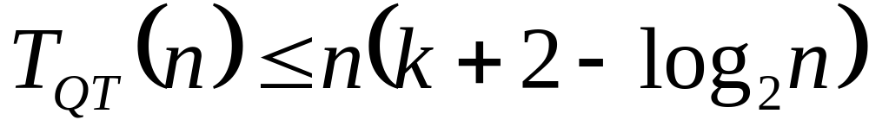
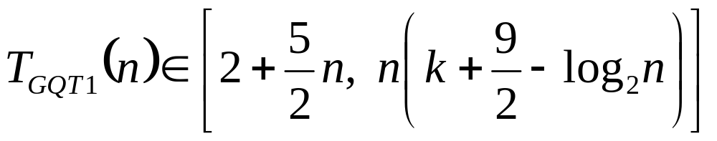
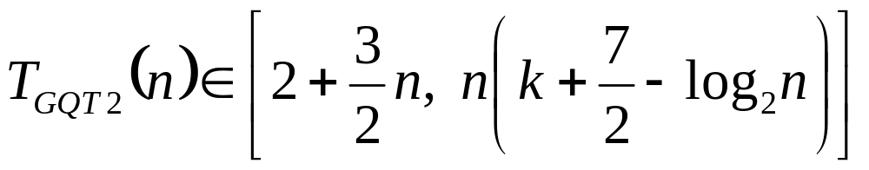
Singulation Time

Slide 16
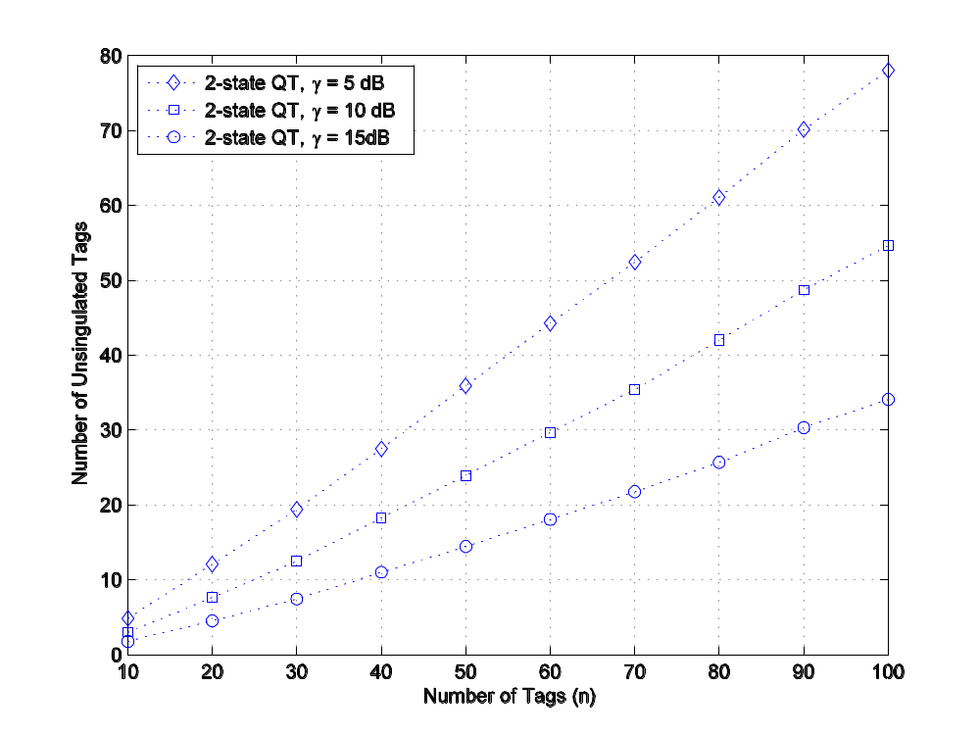
Simulations
Average number of unsingulated tags in 2-state QT.

Slide 17
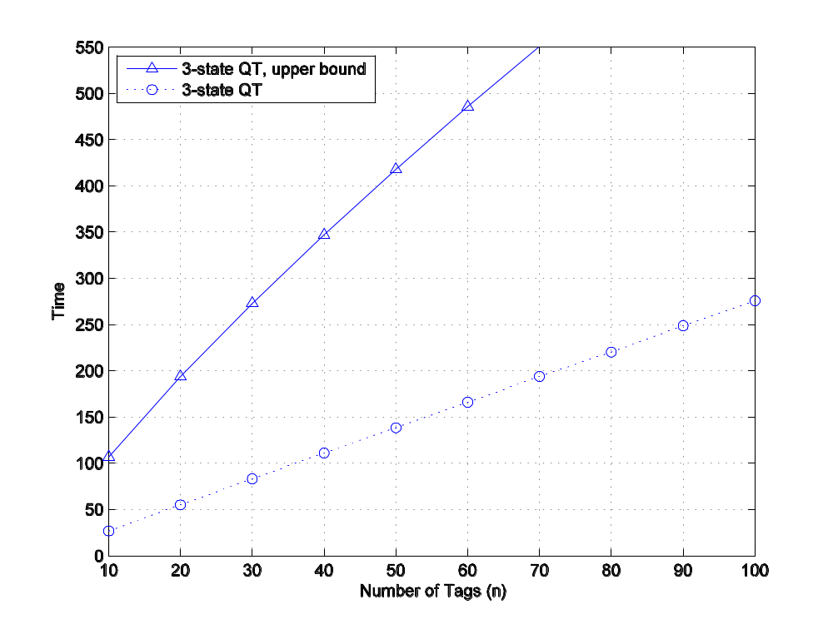
Simulations
Average singulation time of 3-state QT.

Slide 18
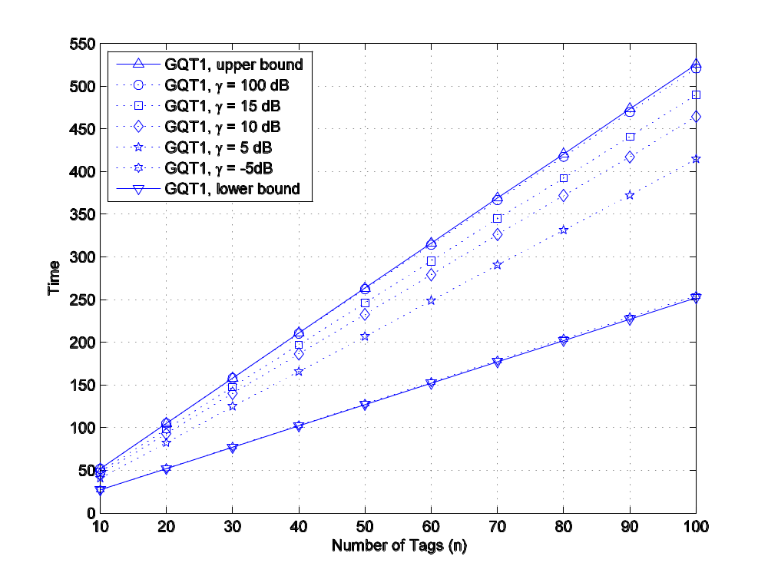
Simulations
Average singulation time of GQT1.

Slide 19
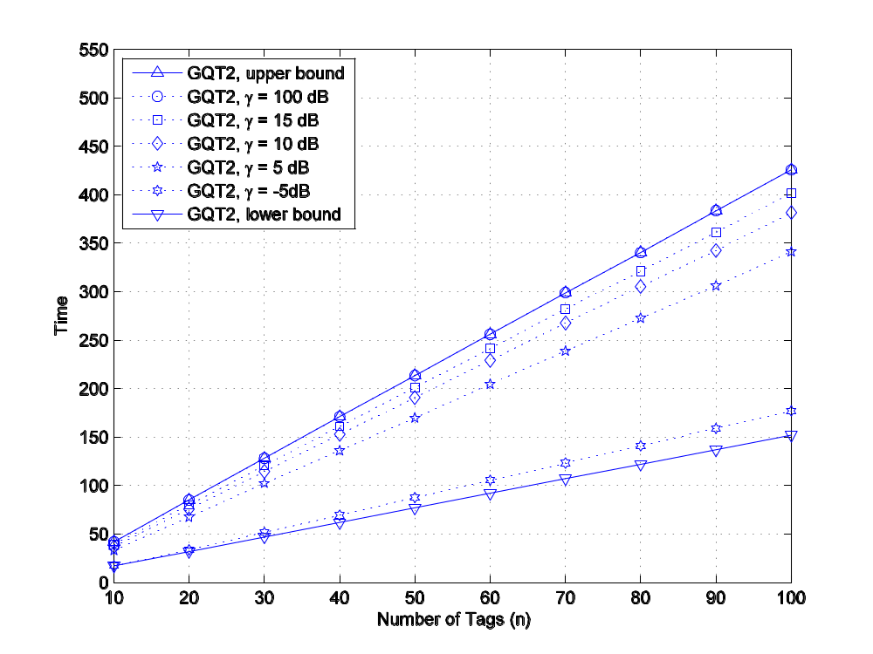
Simulations
Average singulation time of GQT2.

